Slide 1



Username
Password

Slide 2



Welcome to the guild! Please fill up the form to get started nyah nyah!
Full name:
UserName:
Age:
Gender:
Birthday :
Password:
Confirm password
Address:

Slide 3

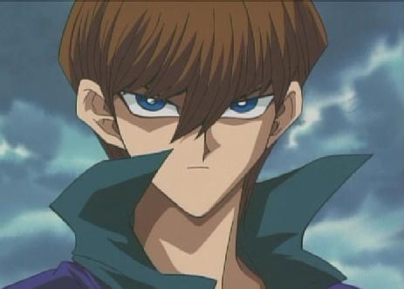



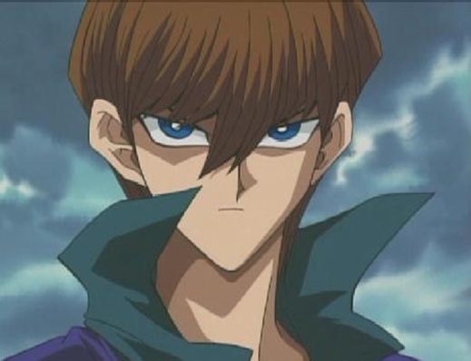


Friends
My Profile
Name: seto kaiba
Username : rich boy999
Age: 25
Gender: male
Birthday: oct 25
Address: domino city,kaibacorporation
Status wall
Feb 2,3553
Joey is a pathetic dog
Neutronblaster22
Whitethunda93
Silversin35
Obelisker223
Breastswitheyesofblu7
Screw the rules I have money!!!
Options bar

Slide 4
